Slide 1
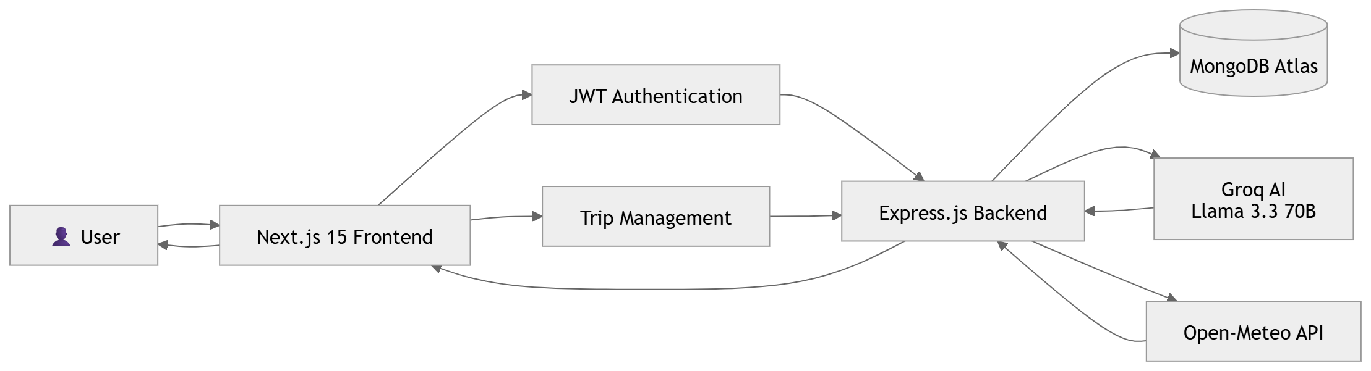
1. Overall System Architecture

Slide 2
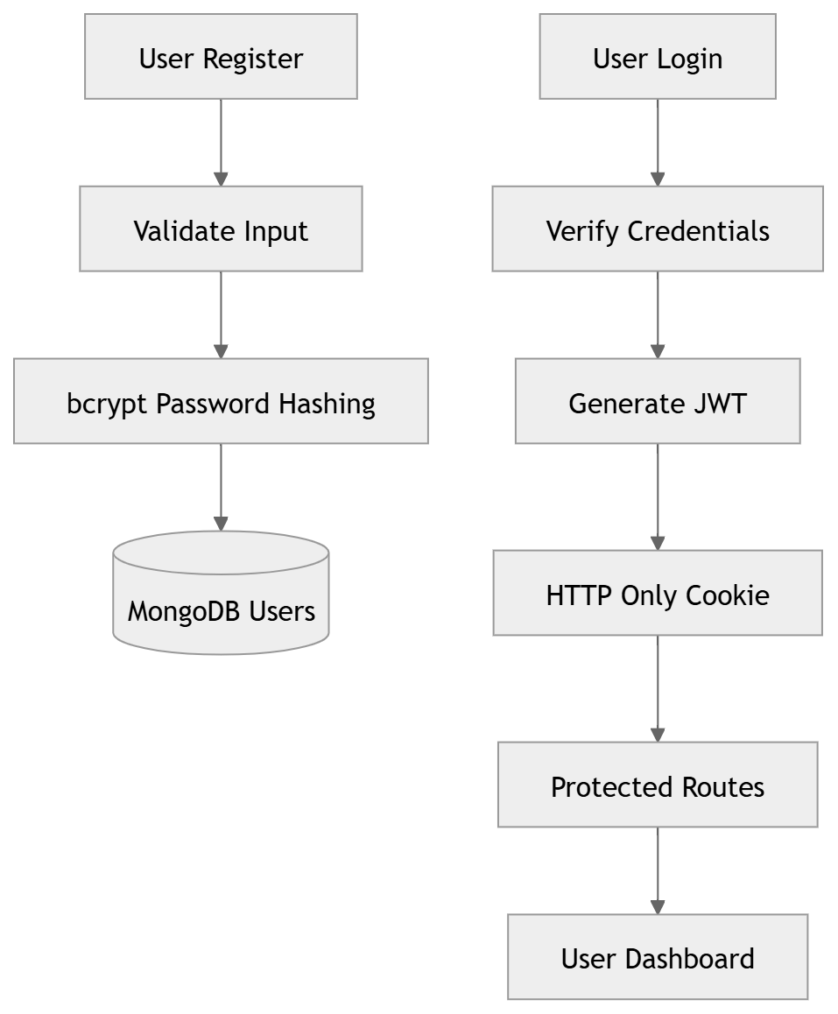
2. Authentication Flow

Slide 3
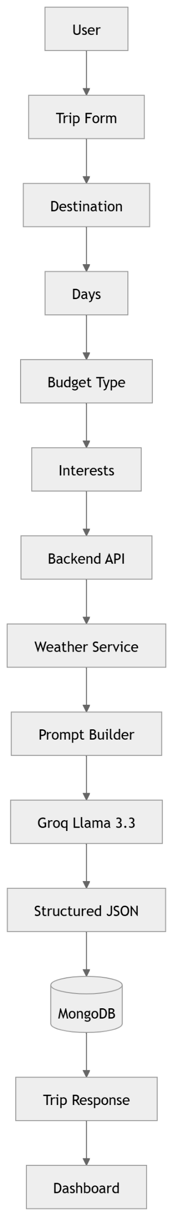
3. AI Trip Generation Flow

Slide 4
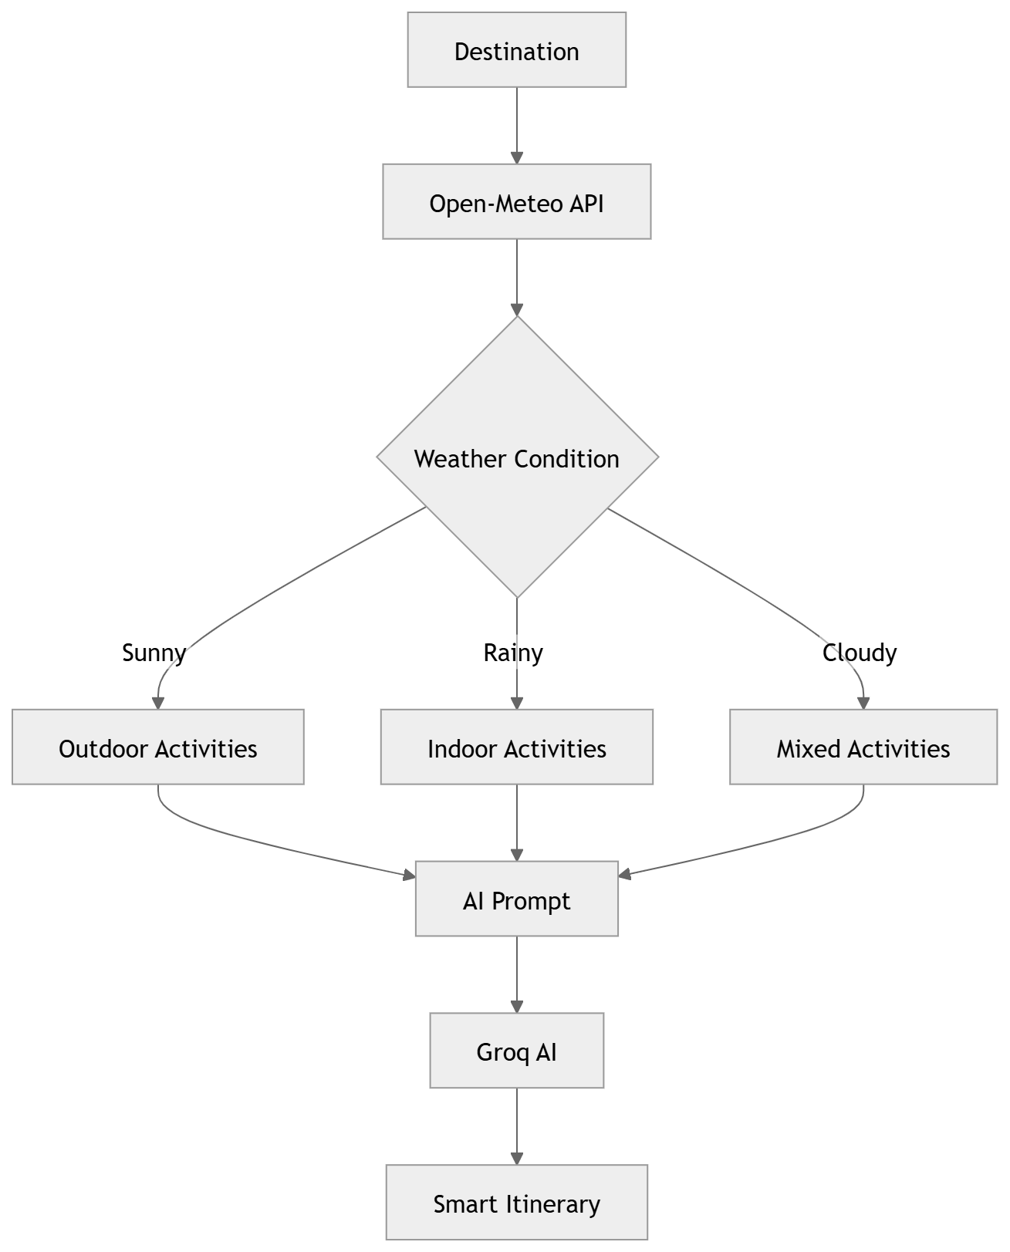
4. Weather-Aware Planning Feature

Slide 5
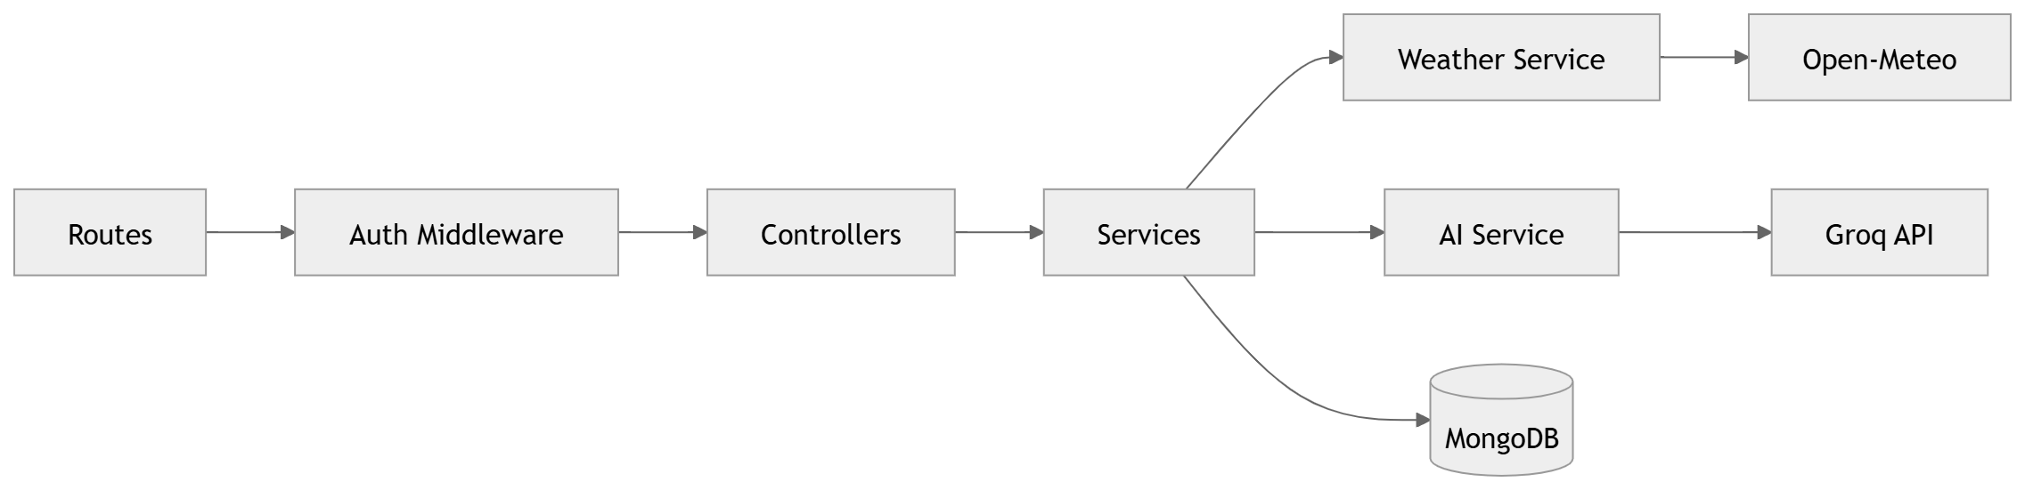
5. Backend Architecture

Slide 6
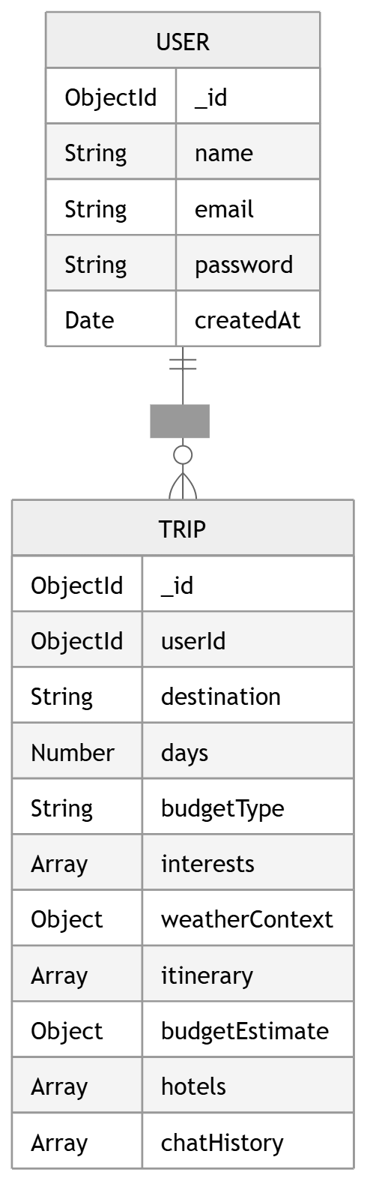
6. MongoDB Schema Relationship

Slide 7
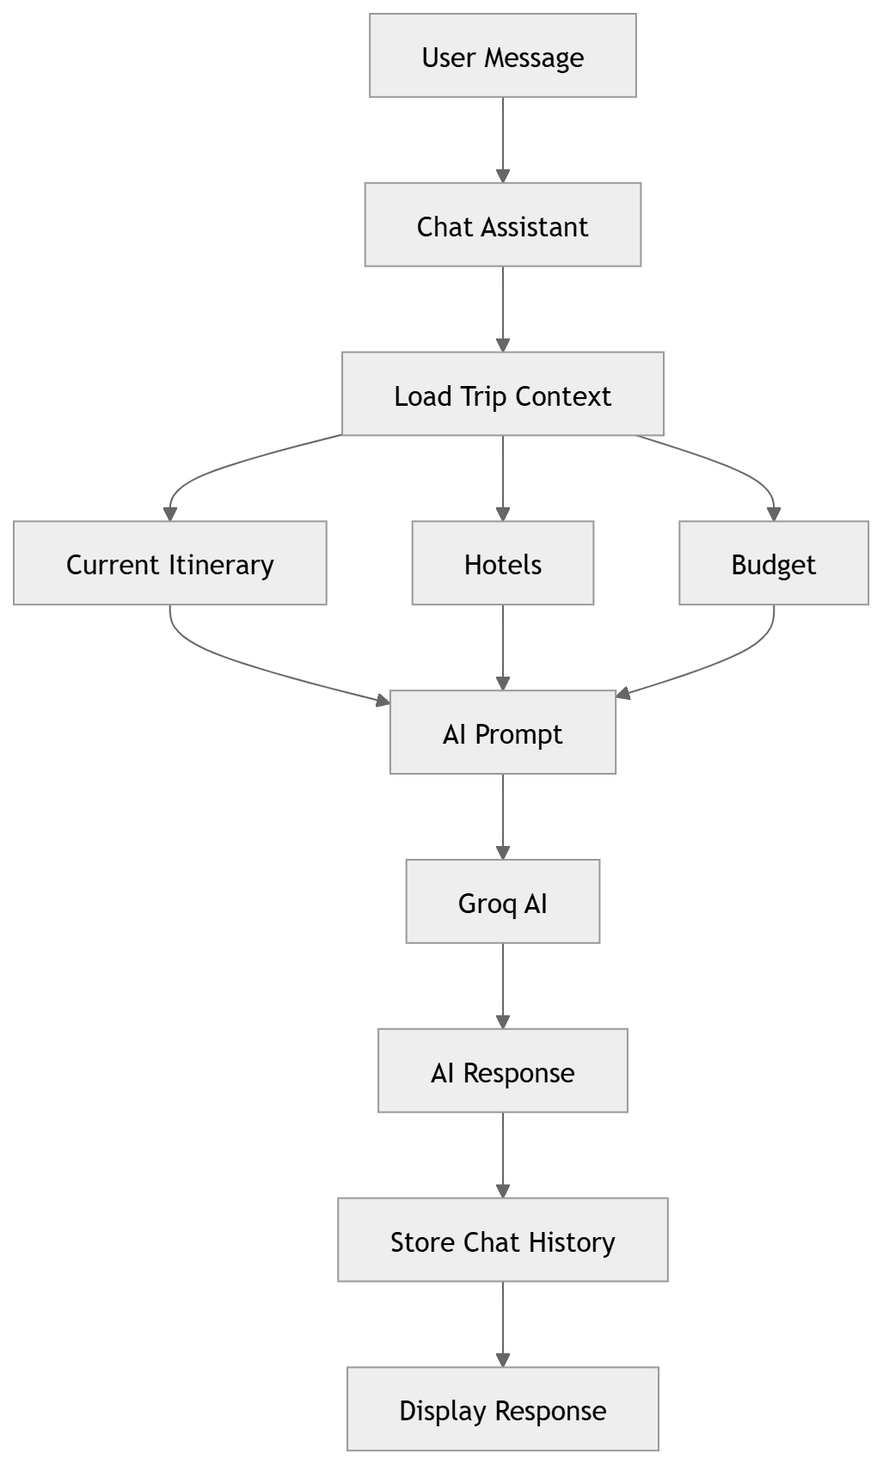
7. AI Chat Assistant Flow

Slide 8
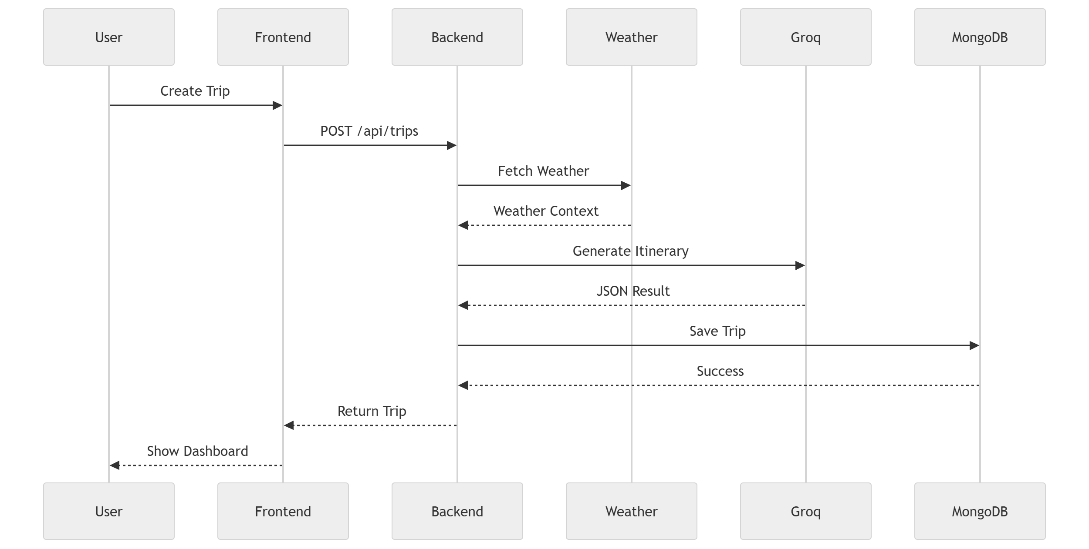
8. End-to-End Request Lifecycle

